Slide 1

EDUCATIONAL MAZE
MEMBERS:Aaliya(TS2122101)
Bhoomika(TS2122115)
Priyanka(TS2122120)
Saranya(TS2122122)
Sharwari(TS2122117)
MENTOR: Prof. Priyanka Dangar

Slide 2

RESEARCH METHODOLOGY
01
PRIMARY DATA
START
DATA COLLECTION
03
02
RESEARCH INSTRUMENT
GOOGLE FORM
AGE:18 to 24
LOCATION: Mumbai city, Mumbai suburbs, Thane to Karjat & Navi-Mumbai to Panvel
TARGET POPULATION
04
FINISH
250
SAMPLE SIZE

Slide 3
GRAPHICAL REPRESNTATIONS
LOCATION WISE DISTRIBUTION
FIRST JOB EXPECTATION
250
SAMPLE SIZE

Slide 4
CHI SQUARE TEST
DECISION CRITERIA
We reject Ho if p value is less than 0.05, P=0.5464
Since p value is more than 0.05 we accept Ho
Ho
There is no association between Working sector encouraged and Mother's qualification.
H1
CONCLUSION
There is an association between Working sector encouraged and Mother's qualification
There is no association between mother’s qualification and the working sector encouraged
250
SAMPLE SIZE

Slide 5
Association between different combinations of variables using Chi-Square
VARIABLE 1 | VARIABLE 2 | P VALUE | DECISION
Working Sector Encouraged | Father’s Qualification | 0.3141 | Accept Ho
Residential Area | Switching in School | 0.5725 | Accept Ho
 | Further Switching | 0.2429 | Accept Ho
 | Marks in SSC | 0.8574 | Accept Ho
 | Marks in HSC | 0.01862 | Reject Ho

Slide 6
LINEAR BY LINEAR ASSOCIATION
DECISION CRITERIA
We reject Ho if p value is less than 0.05, P=0.005746
Since p value is less than 0.05 we reject Ho
Ho
There is no association between Residential area and Marks obtained in SSC/HSC.
H1
CONCLUSION
There is an association between Residential area and Marks obtained in SSC/HSC.
There is significant association between Residential area and marks obtained in SSC/HSC.
250
SAMPLE SIZE

Slide 7
Association between different combinations of variables using Linear by Linear Association.
VARIABLE 1 | VARIABLE 2 | P VALUE | DECISION
Residential Area | Loss of Interest | 0.9211 | Accept Ho
 | Decreasing Scope | 0.3087 | Accept Ho
Stream | Family | 0.8182 | Accept Ho
 | Friend | 0.08675 | Accept Ho
 | Media Platforms | 0.04593 | Reject Ho

Slide 8
KENDALL’S tau ASSOCIATION
DECISION CRITERIA
Ho
We reject Ho if p value is less than 0.05, P=0.008055
Since p value is more than 0.05 we reject Ho
There is no association between marks in SSC/HSC and media platforms of students who switch their ambition
H1
CONCLUSION
There is association between marks in SSC/HSC and media platforms of students who switch their ambition
There is association between marks in SSC/HSC and media platforms of students who switch their ambition
tau
0.18557
250
SAMPLE SIZE

Slide 9
Association between different combinations of variables using Kendall’s tau Association.
VARIABLE 1 | VARIABLE 2 | P VALUE | DECISION
SSC Marks | Satisfaction level | 0.9697 | Accept Ho
HSC | Satisfaction level | 0.1206 | Accept Ho
Financial Status | Mental and Physical health | 1.04626*10^-5 | Reject Ho
Family | Friends | 6.245*10^-6 | Reject Ho
Media Platforms | Role model | 9.681*10^-15 | Reject Ho

Slide 10
PROPORTION TEST
DECISION CRITERIA
We reject Ho if p value is less than 0.45, P=0.00258
Since p value is less than 0.45 we reject Ho
Ho
p=0.45
CONCLUSION
H1
More than 45% students change their ambition.
p > 0.45
250
SAMPLE SIZE

Slide 11
Association between different combinations of variables using Proportion test
VARIABLE 1 | DATA FRAME | P VALUE | Po value | CONCLUSION
Science students switching for first time | 107 of 200 | 0.00905 | 0.45 | Reject Ho
Non science students who switch their ambition | 28 of 50 | 0.01519 | 0.4 | Reject Ho
Science students switch who wants further switch | 51 of 200 | 0.03172 | 0.2 | Reject Ho
Non science students who wants further switch | 12 of 15 | 0.5 | 0.25 | Cannot reject Ho

Slide 12
F
A
C
T
O
R
FACTOR 1: PERSONAL | FACTOR 2:SOCIAL | FACTOR 3:ACADEMIC
O1-Marks in SSC/HSC | O9-Media platforms | O2-Loss of interest in subject
O4-Family | O10-Role model | O3-Decreasing scope of subject/increase in subject
O5-Friends
O6-Financial status
O7-Health( mental & physical )
O8-Teachers & Councilors
A
N
A
L
Y
S
I
S

Slide 13


250
SAMPLE
SIZE

Slide 14


135
SAMPLE
SIZE

Slide 15

CHILDHOOD AMBITION AFTER SWITCHING (STATISTICS RELATED)
54
SAMPLE
SIZE

Slide 16
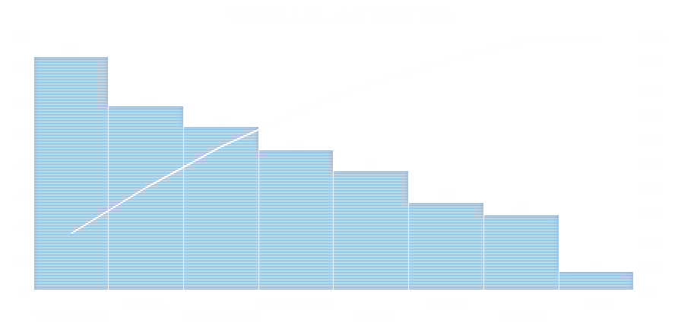
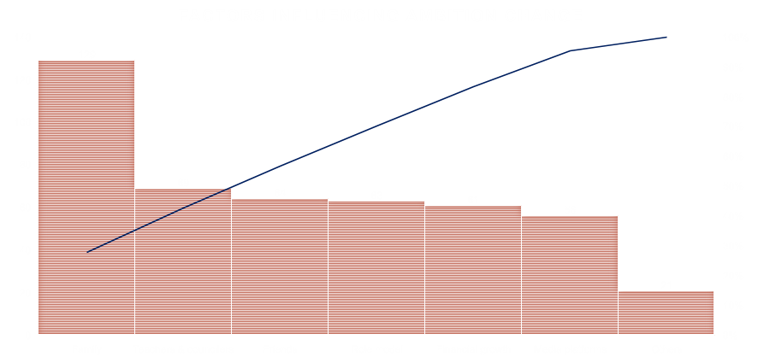

Slide 17
NON PARAMETRIC TESTS
VARIBLE 1 | VARIABLE 2 | HYPOTHESIS | P VALUE | CONCLUSION
Changed first ambition | Want to switch further | Mx>My | 0.003169 | REJECT Ho
 | Didn’t change first ambition | Mx<My | 3.205*10^-6 | REJECT Ho
 | Don’t want to switch further | Mx<My | 5.99*10^-6 | REJECT Ho
Didn’t change first ambition | Want to switch further | Mx>My | 1.01*10^-8 | REJECT Ho
Want to further switch | Don’t want to switch further | Mx>My | 3.352*10^-9 | REJECT Ho
MANN WHITNEY\
Ho;Mx=My
H1;Mx>My
Mx=Median of satisfaction level of people who change their ambition after school
My: Median of satisfaction level of people who don’t want to furthur swtich their career
P value: 0.1617
Since p is greater than 0.05 thus we accept Ho at 0.05 L.O,S
Median satisfaction level of people who did not change their ambition after school is greater than median satisfaction level of people who don’t want to furthur switch their career.
DECISION CRITERIA
CONCLUSION
250
SAMPLE SIZE

Slide 18
NON PARAMETRIC TESTS
WILCOXON’S SIGN RANK TES T
Ho:Medians of Percentages of SSC and HSC are Equal
H1:Medians of percentages of SSC is less than that of HSC
DECISION CRITERIA
We reject Ho if p value is less than 0.05, P=2.2*10^-16
Since p value is less than 0.05 we reject Ho
Median of percentages of SSC and HSC are not equal
CONCLUSION
250
SAMPLE SIZE

Slide 19
YES
SATISFACTION=2,4,7,8,9,10
NO
Teachers & councilors =1,3,5
Role Model=2,3,5
Friends=2,3,4
Media Platforms=4,5
NO
YES
NO
YES
NO
YES
83.6%
250
ACCURACY
SAMPLE SIZE

Slide 20
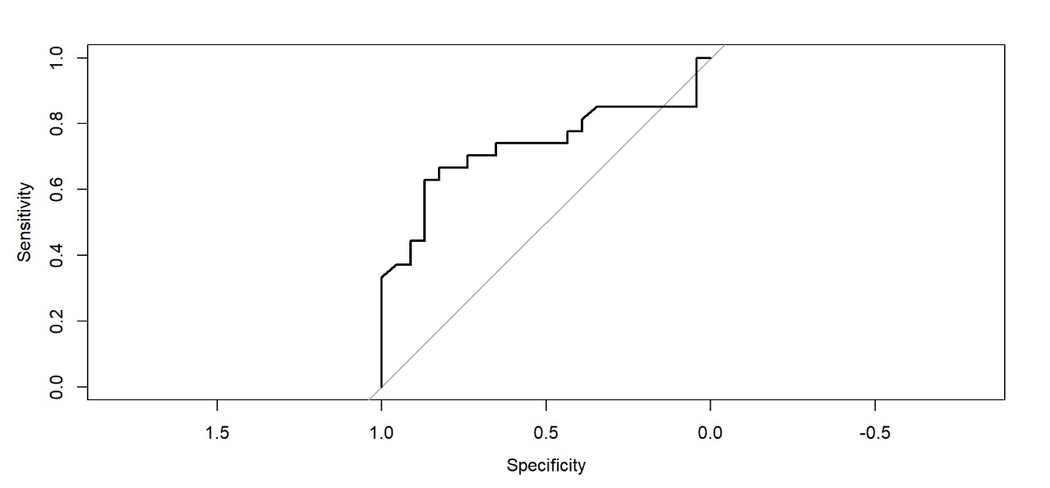
ROC CURVE
 | GVIF | DF | GVIF^(1/(2DF))
O1 | 1.243691 | 1 | 1.115209
O2 | 1.130135 | 1 | 1.063078
O9 | 1.653393 | 1 | 1.285843
O10 | 1.617864 | 1 | 1.271953
JOB 1 | 1.121013 | 6 | 1.009565
BINARY LOGISTIC REGRESSION 1
INDEPENDENT VARIABLE:
O1:Marks in hsc/ssc
O2:Loss/gain of interest in subject
O9:Media Platform
O10:Role model
JOB1: First job expectation
DEPENDENT VARIABLE:
DID YOU SWTICH YOUR AMBITION
YES=1 NO=0
COFUSION MATRIX:
 | 0 | 1
F | 79 | 16
T | 13 | 92
TRAIN DATA
TEST DATA
AKAIKE’S AIC
Accuracy=74%
AUC=0.7311
152.1
Accuracy=85.5%
 | 0 | 1
F | 19 | 9
T | 4 | 18
TEST DATA
250
SAMPLE SIZE

Slide 21
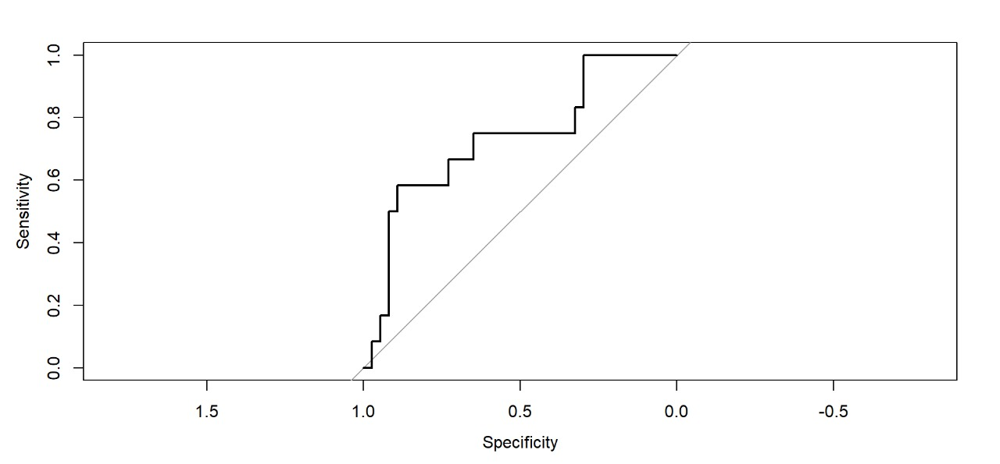
BINARY LOGISTIC REGRESSION 2
ROC CURVE
INDEPENDENT VARIABLE:
PERCENTAGE IN SSC
SATISFACTION RATE
FATHERS EDUCATIONAL QUALIFICATION
 | GVIF | DF | GVIF^(1/(2DF))
SSC | 1.229746 | 1 | 1.108939
SR | 1.236206 | 1 | 1.111848
FEQ | 1.362416 | 5 | 1.031409
DEPENDENT VARIABLE
ARE YOU PLANING FOR FURTHUR CAREER SWITCH
YES=1 NO=0
COFUSION MATRIX:
 | 0 | 1
F | 140 | 34
T | 10 | 17
TRAIN DATA
TEST DATA
Accuracy=73.47%
AUC=0.732
AKAIKE’S AIC
201.61
Accuracy=78.11%
 | 0 | 1
F | 34 | 10
T | 3 | 2
TEST DATA
250
SAMPLE SIZE

Slide 22
GLOBAL TEST
MODEL 1: SWITCH.1 ~ 1
MODEL 2: SWITCH.1 ~ O1 + O2 + O9 + O10 + JOB1
MODEL 1: SWITCH.2~ 1
MODEL 2: SWITCH.2~SSC+SATISFACTION+FATHERS QUALIFICATION
Ho
No independent variable is significant
Resid | DF | Resid.dev | DF | Dev | P
1 | 199 | 275.98
2 | 189 | 130.12 | 10 | 145.86 | 2.2*10^-6
Resid | DF | Resid.dev | DF | Dev | P
1 | 200 | 227.69
2 | 193 | 185.61 | 7 | 42.079 | 5.021*10^-7
H1
At least one independent variable is significant
CONCLUSION
REJECT Ho AND CONCLUDE THAT ATLEAST ONE INDEPENDENT VARIABLE IS SIGNIFICANT IN FITTED MODEL

Slide 23
CONCLUSION
1
3.
Marks and media platforms Health and financial status
Marks and residential area Family and finance Roll models and media platforms
Science students switching more than non science
4.
Maximum students take online courses as a parallel activity
2
5
Family influences the most for the change of ambition
Doctors and engineers then ------》statistician

